Slide 1
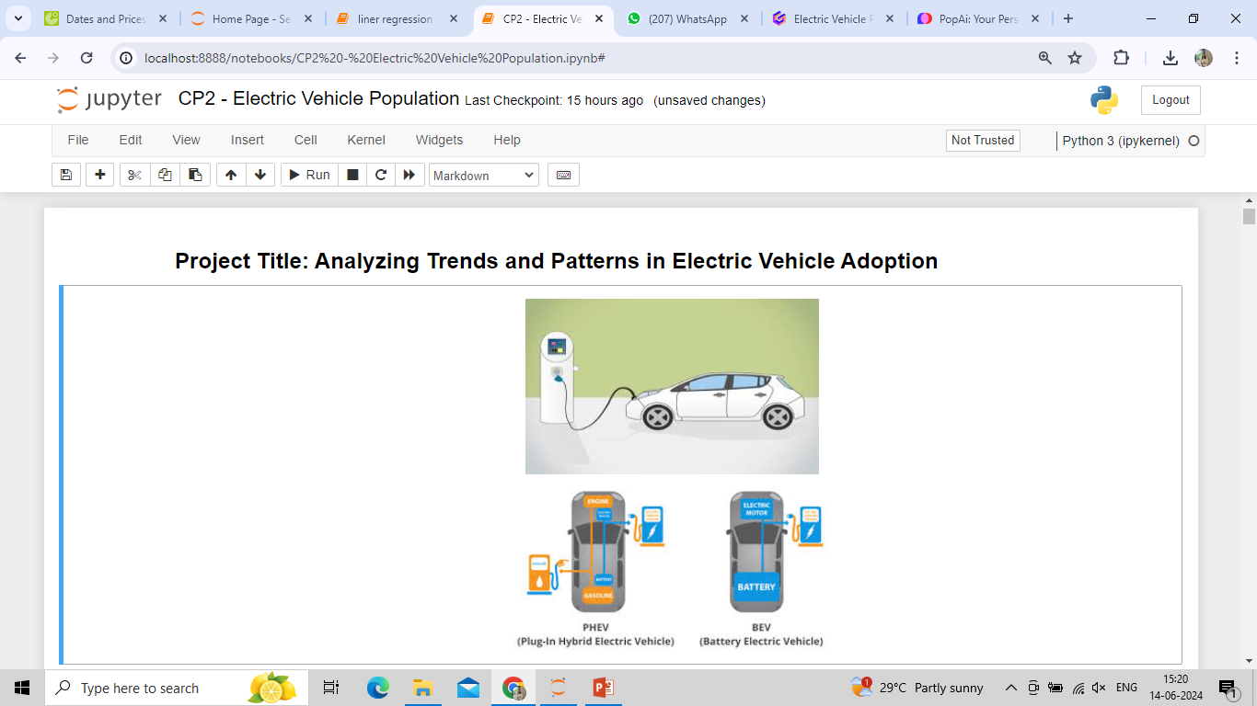
Electric Vehicle Population: Exploratory Data Analysis
This presentation explores the current state and trends of the global electric vehicle (EV) market. Choosing to analyse electric vehicle population data offers a multi-faceted view of how technology, policy, and consumer behaviour intersect. It provides critical insights for stakeholders across government, industry, and academia to drive forward the transition to sustainable transportation.
by Gauri Sanjay Wagh
PGA 48

Slide 2
Objectives :
1. To analyse the growth trends of electric vehicle adoption over the past few years.
2. To assess the current population of electric vehicles in different regions.
3. To identify factors influencing the adoption of electric vehicles.
4. To forecast future trends in electric vehicle population.
Tools and Technologies
Python: For data manipulation, analysis, and visualization (using libraries such as Pandas, NumPy, Matplotlib, Seaborn, Plotly).
Machine Learning: Using Scikit-learn for predictive modeling.
Jupyter Notebooks: For documenting the analysis process and results.

Slide 3
Idea of the Project
The adoption of electric vehicles (EVs) is a critical component in the global effort to reduce greenhouse gas emissions and combat climate change. As the automotive industry undergoes a transformative shift towards sustainable energy, understanding the dynamics of the EV population becomes increasingly important for policymakers, manufacturers, and consumers alike.
Purpose of the Project
This exploratory data analysis (EDA) project aims to investigate and uncover patterns, trends, and insights within the electric vehicle population. By analysing various datasets related to EVs, we intend to gain a comprehensive understanding of the factors influencing the adoption and distribution of electric vehicles across different regions and demographics.

Slide 4
1. Data Exploration and Cleaning
2. Descriptive Statistics and Visualization
3. Geographical Analysis
4. Market Analysis
5. Predictive Analysis
Project Outline: Analysis of Electric Vehicle Population Data

Slide 5
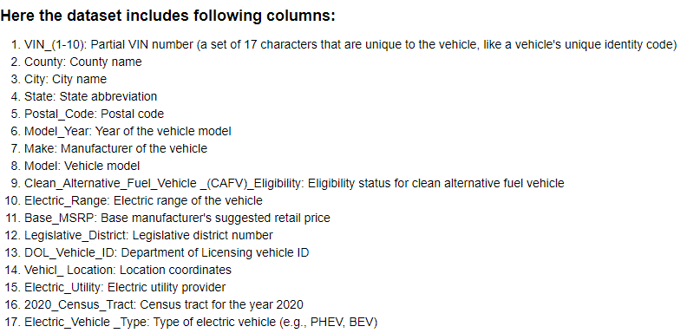
This dataset is Consist of 17 Columns and 181458 rows.
And Each column have information about Specific category.

Slide 6
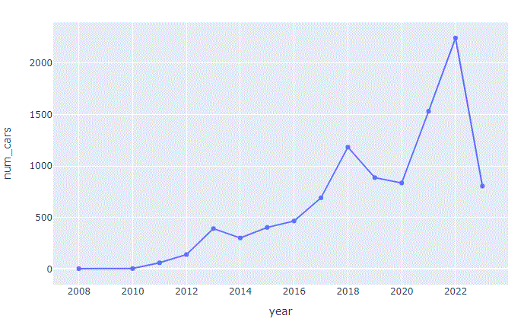
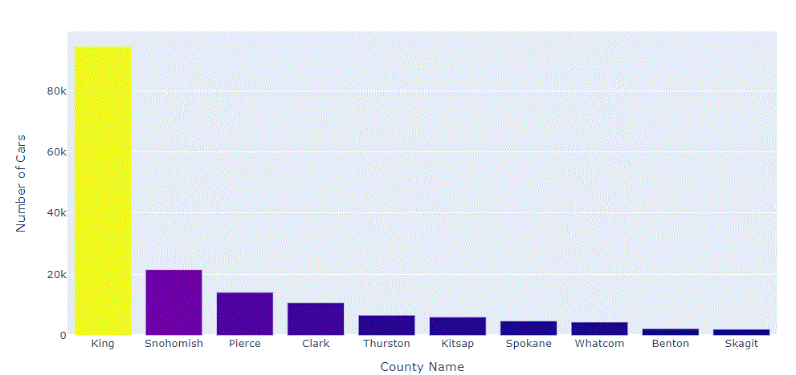
Q.1. What is the year wise Car sales grow?
Q.2. What are top 10 count of
Cars per county ?
(A county is a specific region
of a state or country)

Slide 7
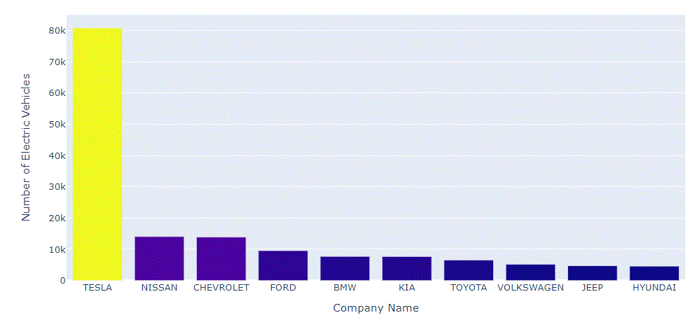
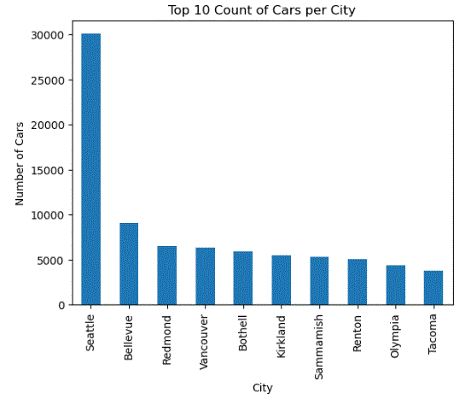


Q.3. Which are top 10 Companies making
most Electric Vehicles ?
Q.4. Which are top 10 Count of Cars
per City?
0 : Battery Electric Vehicle (BEV)
1 : Plug-in Hybrid Electric Vehicle (PHEV)

Slide 8
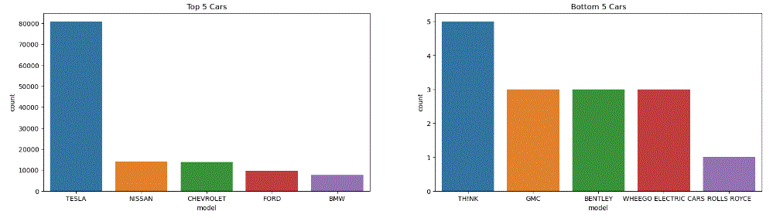
Q.5. Comparison between top 5 and bottom 5 Car Companies

Slide 9
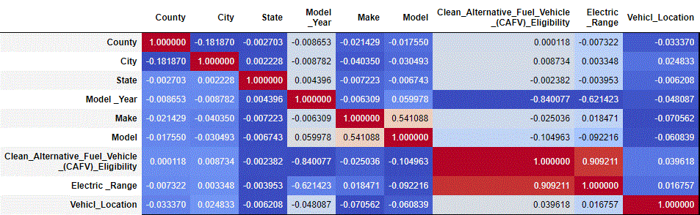
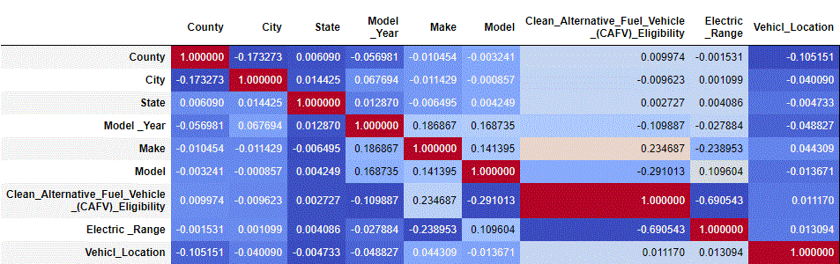
Correlation for BEV
(Battery Electric Vehicle
(BEV))
Correlation for PHEV
(Plug-in Hybrid Electric
Vehicle (PHEV) )

Slide 10
Exponential Growth in EV Sales
2025 (Projected)
EV sales estimated to exceed 12 million units, driven by falling battery costs and expanding model availability.
2015
Global EV sales reach 550,000 units.
1
2
3
2020
EV sales surpass 3 million units, a six-fold increase in 5 years.

Slide 11
Leading EV Markets
China
Europe
United States
Accounts for over 50% of global EV sales, driven by generous subsidies and aggressive targets for EV adoption.
Rapid growth, with Norway, Germany, and France leading the way. Policies like emission regulations and purchase incentives have fueled adoption.
The second-largest EV market, with California as the dominant state. Federal and state-level policies have supported EV sales.

Slide 12
Environmental Impact of EVs
Reduced Emissions
Energy Efficiency
Renewable Integration
EVs produce significantly lower greenhouse gas emissions than traditional gasoline-powered vehicles, even when accounting for electricity generation.
EVs are more energy-efficient, converting over 77% of the electrical energy from the grid to power at the wheels, compared to only 12-30% for gasoline vehicles.
The growth of EVs can support the integration of renewable energy sources like solar and wind, helping to decarbonize the transportation sector.

Slide 13




Charging Infrastructure Expansion
Home
Charging
Workplace Charging
Public
Charging
Fleet
Charging
Convenient and cost-effective option for EV owners to charge their vehicles overnight.
Allowing employees to charge during the day supports EV adoption and reduces range anxiety.
Expanding networks of fast charging stations along highways and in urban areas enables longer-distance travel.
Specialized charging solutions for commercial and municipal fleets accelerate EV adoption in professional settings.

Slide 14



Policy Landscape and Incentives
Emissions Regulations
Purchase Incentives
Infrastructure Investments
Subsidies, tax credits, and rebates make EVs more affordable for consumers.
Stricter vehicle emission standards drive automakers to increase EV production.
Government funding for charging networks and grid modernization supports EV adoption.

Slide 15

Challenges and Barriers
1
Charging Availability
2
Battery Cost
Limited public charging infrastructure, especially in rural and underserved areas, hinders EV adoption.
Though declining, the higher upfront cost of EVs compared to traditional vehicles remains a barrier.
3
Consumer Awareness
Lack of education and misconceptions about EVs' capabilities and benefits slows widespread acceptance.

Slide 16
Future Outlook and Opportunities
Increased Model Availability
More EV options across vehicle segments, including SUVs, pickup trucks, and luxury models.
Longer ranges, faster charging, and lower costs will make EVs more practical and affordable.
Improved Battery Performance
Autonomous Driving Features
Advanced self-driving technologies will integrate well with the electric powertrain.
Grid Integration and V2G
EVs can act as distributed energy storage, enabling vehicle-to-grid (V2G) capabilities.

Slide 17
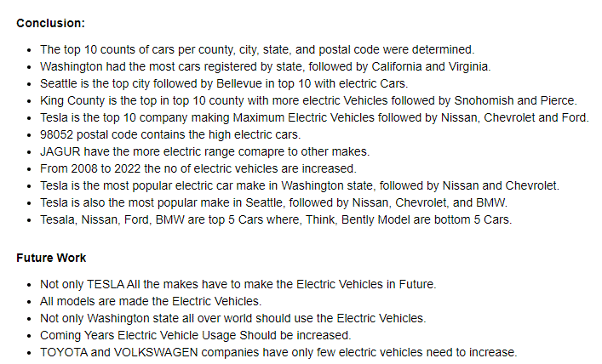
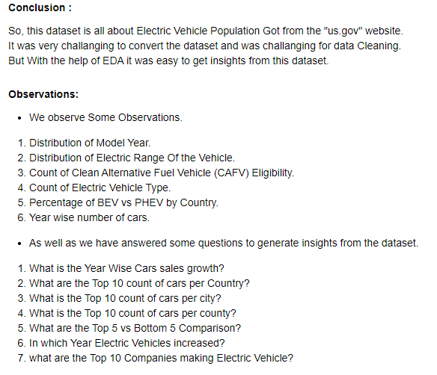
Conclusion
Observations
Future Work

Slide 18


